Slide 1
Tasks completed (9 April)
Contained vs uncontained 2-photon shower selection

Slide 2
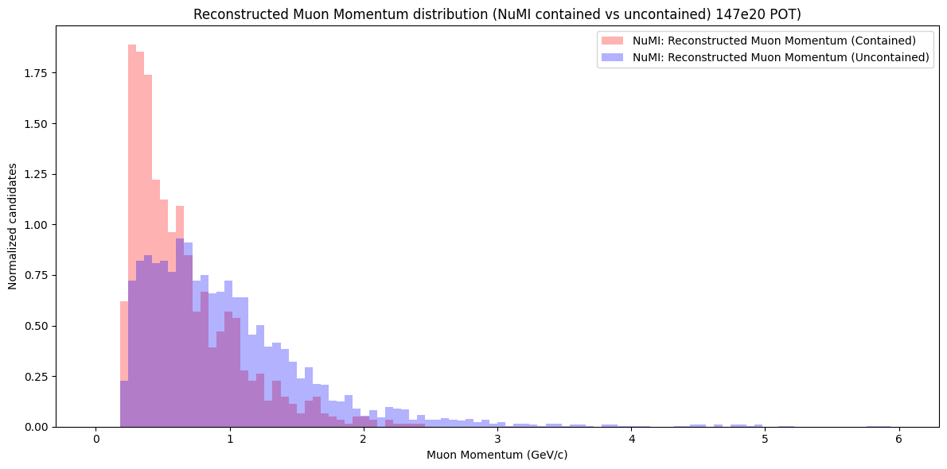
Contained vs uncontained selection (Muon momentum)

Slide 3
Separation by interaction mode
Looking at the true interaction mode variable of the reconstructed interaction
Separating by the 3 main interaction types (QE, RES, DIS)

Slide 4
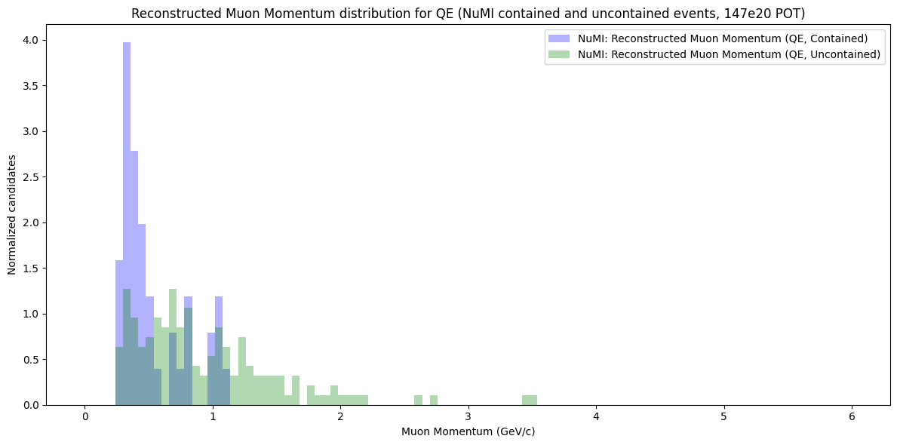
Contained vs uncontained selection (QE)

Slide 5
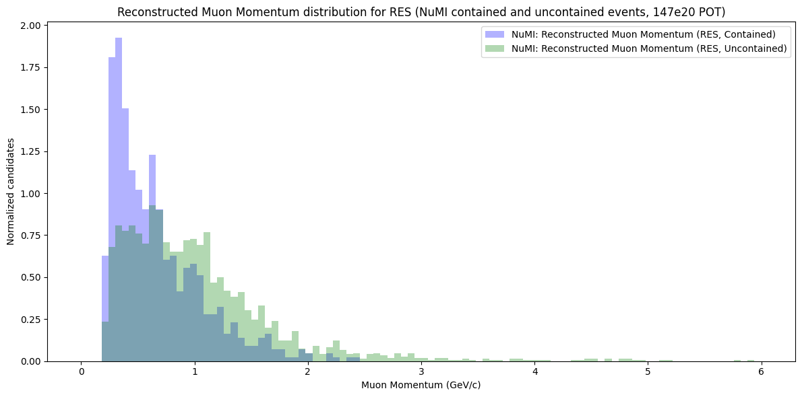
Contained vs uncontained selection (RES)

Slide 6
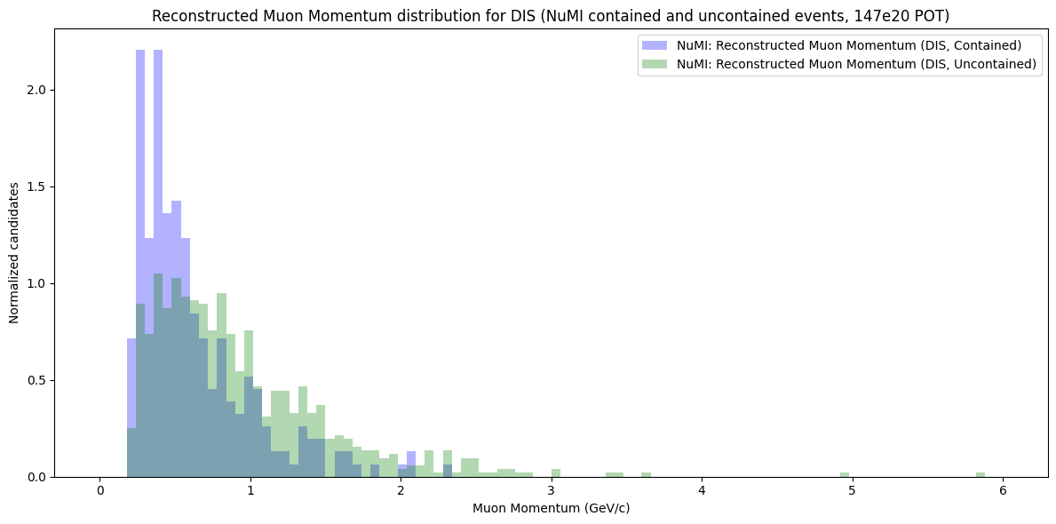
Contained vs uncontained selection (DIS)

